Slide 1
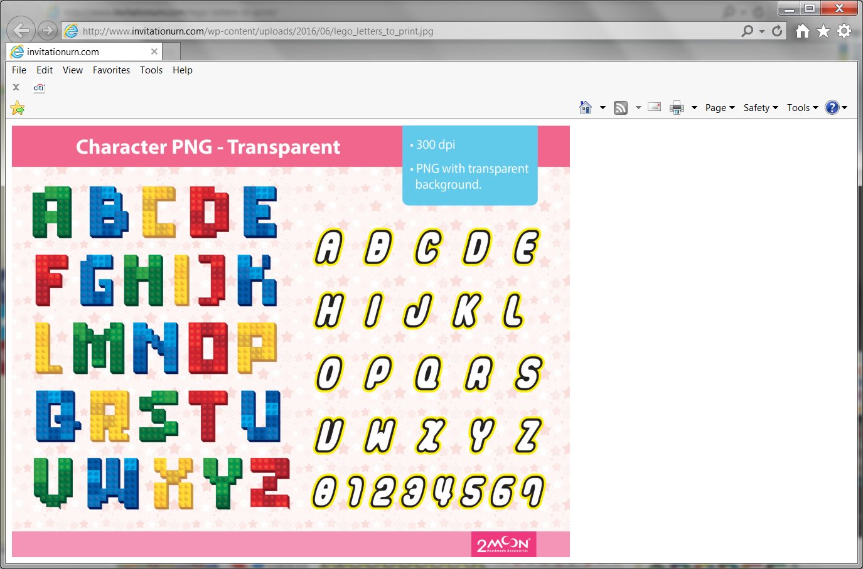
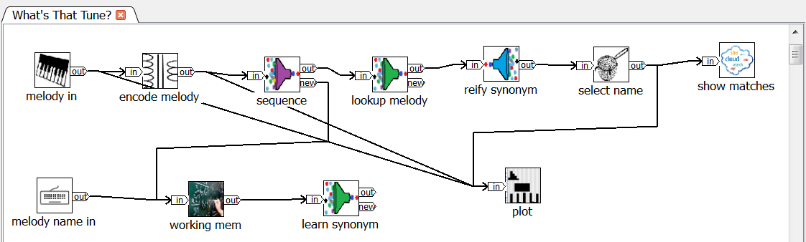
NeurOS™ and NeuroBlocks™ A Neural Operating System and Cognitive Building Blocks
Lee Scheffler, Cognitivity
portable
scalable
embeddable
extensible
Rapidly build/run cognitive systems
Notes:
My name is Lee Scheffler
I’d like to introduce you to some technology I’ve been developing over the past couple of years.
I really wanted to call this technology "Brain LEGOs", but I don’t want to get into trademark trouble.
A couple of years ago I started prototyping some cognitive processing ideas and found I was doing similar things over and over.
So I wound up developing an open general-purpose platform to make it easy to rapidly build and run various cognitive functions.

Slide 2
narrow
intelligence
broad
intelligence
NeurOS
"conventional"
machine
learning
one/few shot learning
continuous learning
teaching
abstraction, generalization
hierarchy/heterarchy
sets, sequences, temporal seqs

Slide 3
Deep Learning Challenges
Abstraction/generalization
learn abstractions in a few trials
Need huge amounts of well-representative training data
one/few-shot/continuous learning
Hierarchical structures
classes, subclasses, instances, ..., synonyms,
Nuance
Opaque
Stability (of data statistics)
continuous learning
"Big" failures – too shallow, no committee, common-sense
Work in alternative circumstances with novel data
Teachable

Slide 4
Deep Learning Challenges
DL Challenge | NeurOS Response
abstraction/generalization | learn abstractions in a few trials
needs too much well-representative data | one/few-shot, continuous learning, teachable
hierarchical structures | classes, subclasses, instances, synonyms, heterarchies
causal relationships
opaque | flow, function and pattern structure accessible, modifiable (even while running!)
stability of data statistics | continuous learning
"big" failures – too shallow, no committee, no common sense | easy complex structuring of abstractions
work in alternative circumstances with novel data | yes

Slide 5
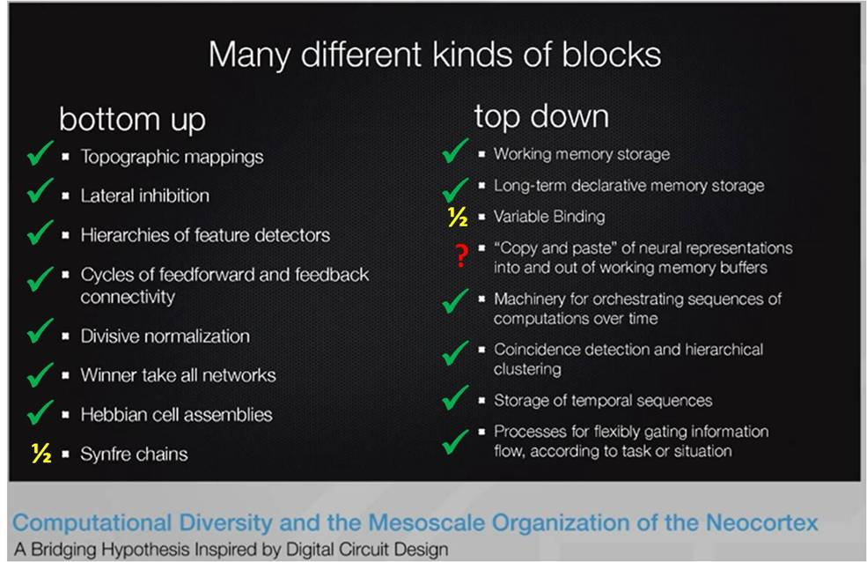

Slide 6
NeurOS and NeuroBlocks in a Nutshell
Build cognitive systems… … by linking reusable modules … … into directed neural graphs/circuits
Broad applicability
Rapid iterative visual flow development
Open, extensible, embeddable, portable, scalable, …

Slide 7
Positioning
"classical" AI
(symbolic)
NeurOS
NeuroBlocks
(functional)
probabilistic, connectionist
models
abstraction
spiking
simulations
synapse-level simulations
biological fidelity
Notes:
I take my life in my hands with this slide. But I thought it was important to give you a perspective to get your bearings.
Hopefully I’m misrepresenting, neglecting or insulting everyone equally so maybe it will all balance out.
NeurOS and NeuroBlocks model biological brains at a level of abstraction above synapses and spikes: groups and assemblies of neurons.
A major goal is to enable building progressively higher abstractions via composition.
In particular, the architecture is aimed at practical, usable, scalable, portable software implementation.

Slide 8
Virtuous Research Cycle
model
Understand
and emulate
biological brains
biological
brains
NeurOS
"brains"
hypothesize

Slide 9
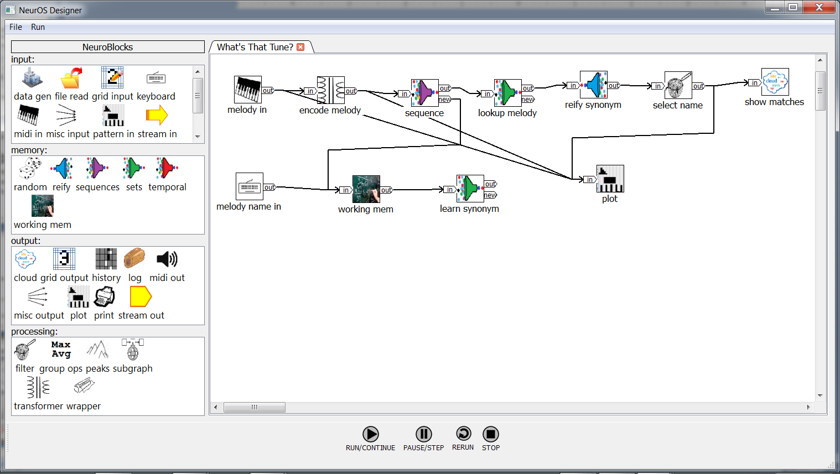
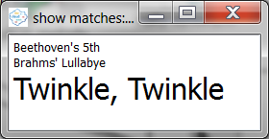
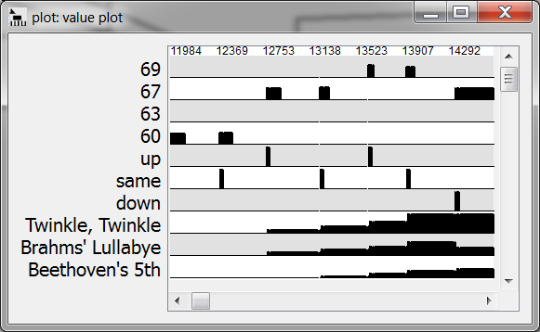
Example: What's That Tune?
NeurOS Designer IDE
Drag&drop
neural graph
design canvas
NeuroBlocks
parts bin
Output module displays
Notes:
Before diving into details, I want to give you the flavor of the system with an example that illustrates many (but not all) of the concepts.

Slide 10
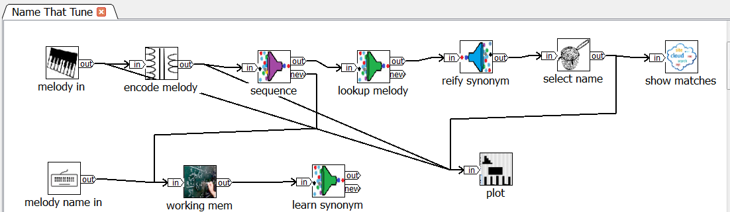
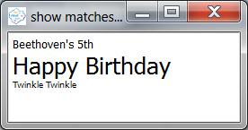
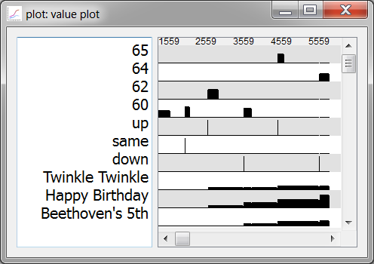

What’s That Tune?
What’s That Tune?
①
③
②
same pattern
space
① melody encoded
② new melody and name associated
④
③ melody recognized and name(s) shown
④ progressive recognitions with new events

Slide 11
Point of View
Plausible biological implementation
leaky integrate and fire neurons
fixed spiking, finite variable rate
multiple neuron morphologies
dendritic computation
synapse conductivity and change
brain connectivity/pathways
known algorithms/structures (e.g., cross-inhibition)
incremental learning, asymptotic

Slide 12
Basics
neural graph:
module
module
events
out
in
out
in
links

Slide 13
Basics
neural graph:
events
out
in
out
in
links
module | Group/layer of neurons or dendritic branches with similar function; state
link | Mulitiplexed event signal path: axons of multiple neurons
neural graph | Directed flow, loops, nestable sub-graphs
event | New spiking rate of a neuron

Slide 14
Basics
neural graph:
events
out
in
out
in
links
module | Group/layer of neurons or dendritic branches with similar function; state
link | Mulitiplexed event signal path: axons of multiple neurons
neural graph | Directed flow, loops, nestable sub-graphs
event | New spiking rate of a neuron

Slide 15
Basics
neural graph:
events
out
in
out
in
links
module | Group/layer of neurons or dendritic branches with similar function; state
link | Mulitiplexed event signal path: axons of multiple neurons
neural graph | Directed flow, loops, nestable sub-graphs
event | New spiking rate of a neuron

Slide 16
Basics
neural graph:
events
out
in
out
in
links
module | Group/layer of neurons or dendritic branches with similar function; state
link | Mulitiplexed event signal path: axons of multiple neurons
neural graph | Directed flow, loops, nestable sub-graphs
event | New spiking rate of a neuron

Slide 17
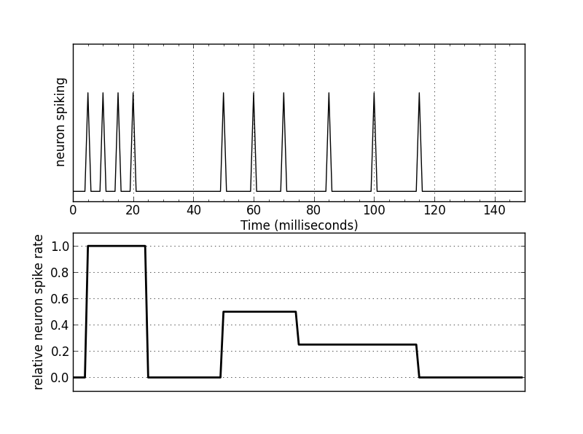
Basics
neural graph:
events
out
in
out
in
links
max rate
50% rate
33% rate
event code:
(0, id,1.0)
(25, id,0)
(50,id, 0.5)
(75, id,0.33)
(120, id,0)

Slide 18
A Link Is a (Pre-synaptic) Bus
fur
barks
tail
dog

Slide 19
A Link Is a (Pre-synaptic) Bus
fur
barks
tail
dog
Signals (events) are delivered to all "neurons" in target module.
Only targets (neurons) with non-0 weight synapses are prodded.
Sufficient concurrent input signal values may activate a target(s)

Slide 20
A Link Is a (Pre-synaptic) Bus
fur
barks
tail
dog
meows
New feature signals may show up at any time

Slide 21
A Link Is a (Pre-synaptic) Bus
fur
barks
tail
dog
meows
cat
New pattern(s) may include old and new features.

Slide 22

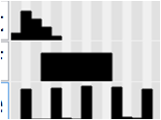


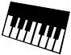


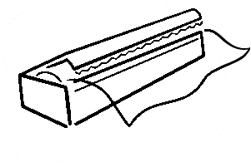
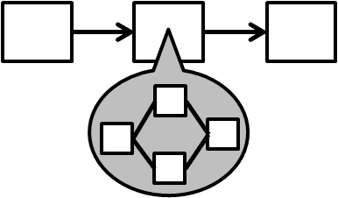
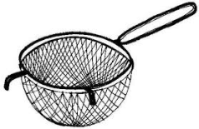
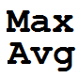
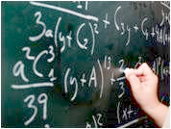
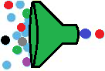







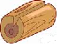

Module Types
inputs (senses)
processing
memory
outputs (actions, effectors)
keyboard
temporal pattern in
grid in
data gen
stream in
MIDI in
filter
transformer
group ops
wrapper
subgraph
working
memory
set
patterns
sequence
patterns
temporal
patterns
pattern
reify
print
plot
cloud
grid out
stream out
log
MIDI out
Notes:
Not a complete list – just representative of the major ones

Slide 23
Memory Pattern Module Types
Sets | Concurrent feature collections in any order Semantic range: any/OR, a few, some, many, most, all/AND
Sequences | Time-independent sequences of features Parameters for non-exact sequence matching
Temporal Patterns | Time-relative sequences of multiple features Parameters for non-exact matching, speed range
Reify | Inverse: generate pattern features e.g., prediction, imagination, expectations, feedback
Notes:
As you will see, much is accomplished with compositions of patterns: sequences of sets of sequences.

Slide 24
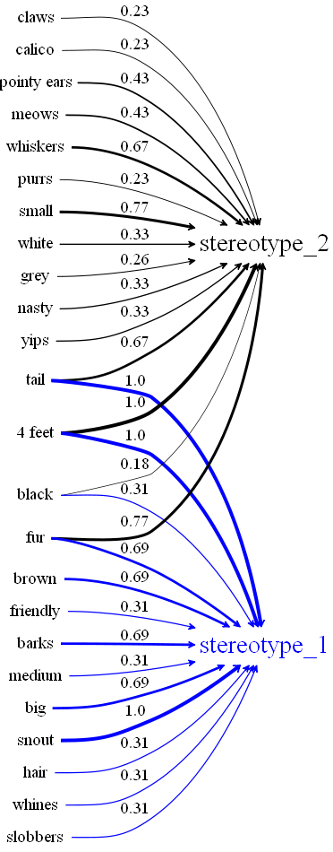
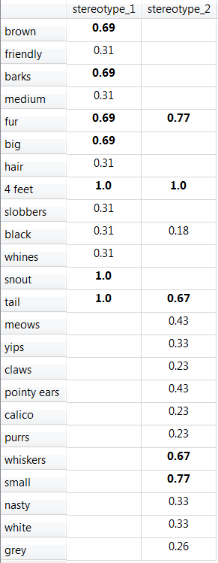
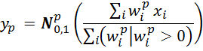
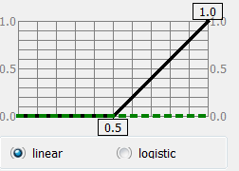
Set patterns
"dog"
"cat"
Weighted sum of current inputs
"cat"
y_{p} pattern output
x_{i} i^{th} input feature
w_{i} i^{th} input feature weight
N^{p} activation function
"dog"

Slide 25
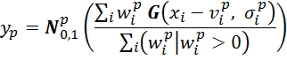
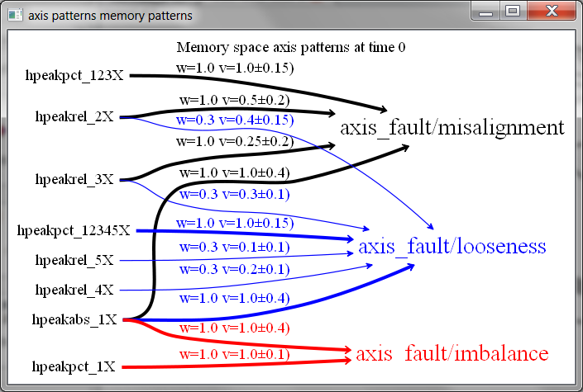
Set Value Difference Patterns
Weighted sum of current input value differences from means
y_{p} pattern output
x_{i} i^{th} input feature
v ^{p}_{i} i^{th} expected value
σ ^{p}_{i} i^{th} spread (stdev)
w_{i} i^{th} input feature weight
G Gaussian(mean, stdev)
N^{p} activation function

Slide 26
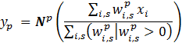
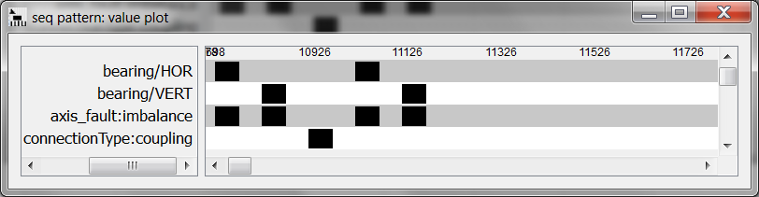
Sequence Patterns
Time-independent weighted sum of inputs over successive steps
step: 0 1 2 3 4
y_{p} pattern output
x_{i} i^{th} input feature
w_{i,s} i^{th} input feature weight at step s
N^{p} activation function

Slide 27
Sequence Value-Difference Patterns
Time-independent weighted sum of inputs value differences from
expected (mean) value over successive steps

Slide 28
Temporal Sequence Patterns

Slide 29
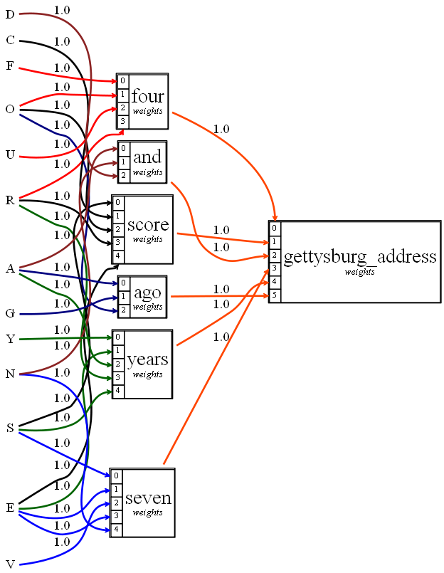
Pattern Examples
"cat"
"dog"

Slide 30
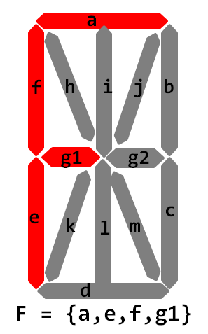
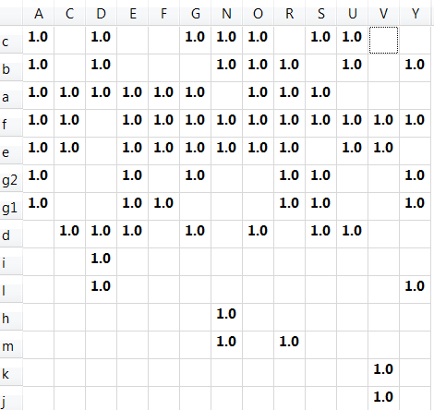
Layers of Patterns
letter
LED segment

Slide 31
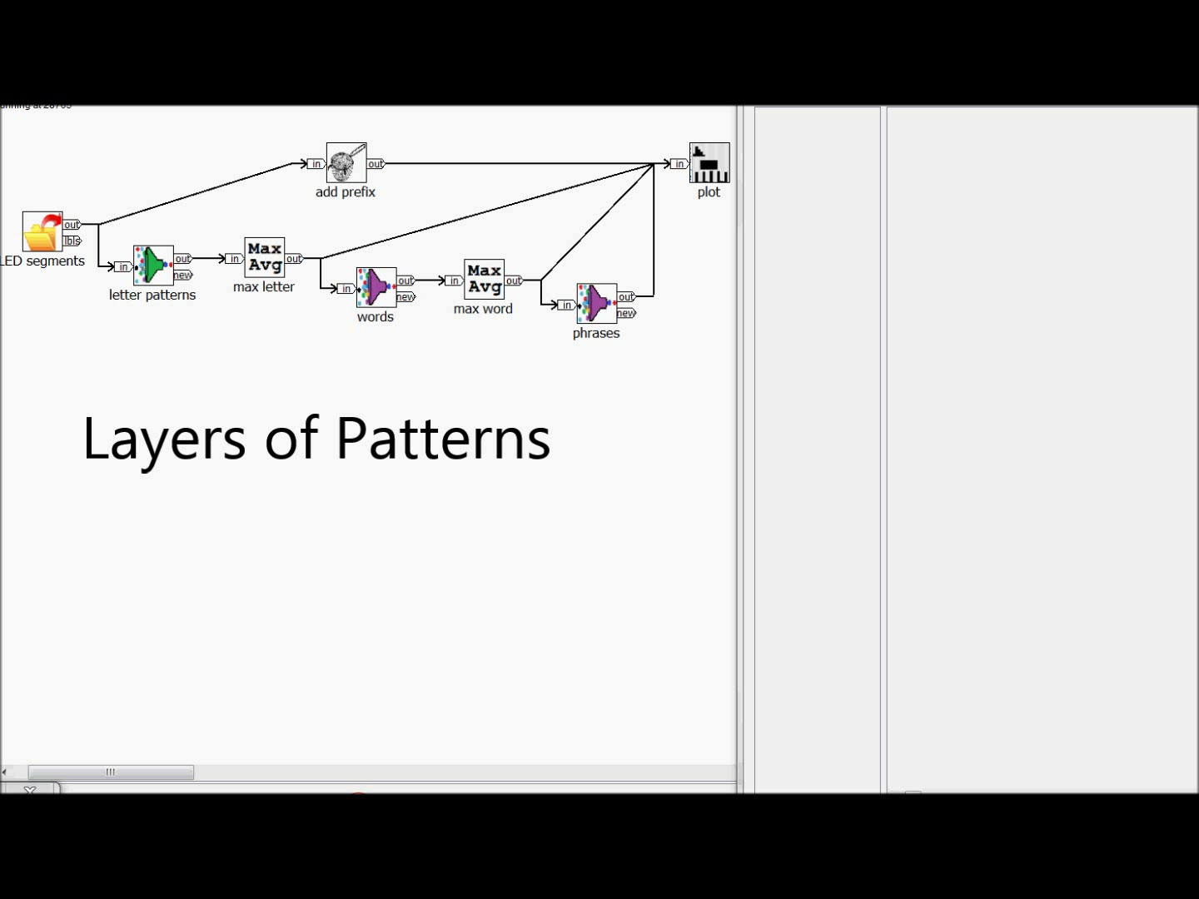

Slide 32
Pattern Learning
Current inputs match an existing pattern well-enough?
novelty threshold parameter
adjust feature weights of best matching pattern(s); learning rate parameter, annealing
Otherwise:
create a new pattern from the current inputs
--No gradient descent or backprop!--
Enables complex pattern heterarchies
specific exemplars, stereotypes, ...
layers of recombination of abstractions

Slide 33
Typical Cognitive System Structure
sensory preprocessing
feature/invariant extraction
dimensionality reduction
multiple channels
predictions
expectations
imagination
outputs, actions
multiple channels
merging
pattern learning and recognition
behavior
patterns
abstraction
reification
sensory/attention control
external world
user, environment

Slide 34
NeurOS Strengths
One/few-shot learning
no huge training sets
Continuous on-line learning
Unsupervised, supervised ("teaching"), transfer learning
Few configuration "hyper-parameters“
Accessible inner workings, visualization
Flexible, embeddable, …

Slide 35
Usages (“app notes”)
overview basics memory design patterns examples architecture directions
multi-solution/path
perception
working memory
words and sequences
phrases and concepts
prediction
synonyms, naming
conjunction-disjunction
classification
context priming
state modulation
teaching
batch/online learning
concentration/ interruption
imagination
where’s Willie?
"thinking"
experience filter

Slide 36
Prototype Applications
overview basics memory design patterns examples architecture directions
Motion tracking
Behavior
Anagrams
Crossword puzzles
Cousins
Whats-That-Tune? enhanced version

Slide 37
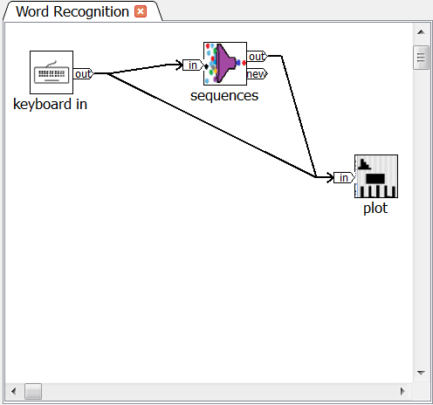

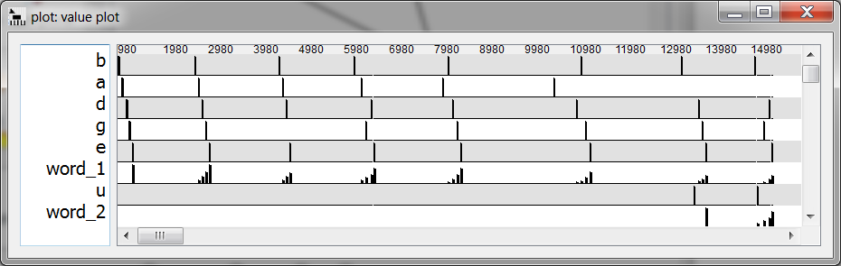
Words and Sequences

Slide 38
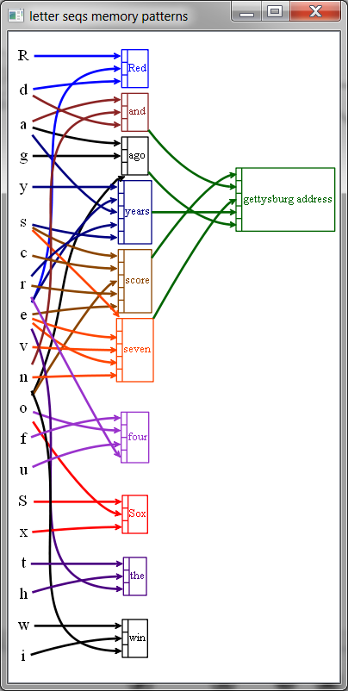
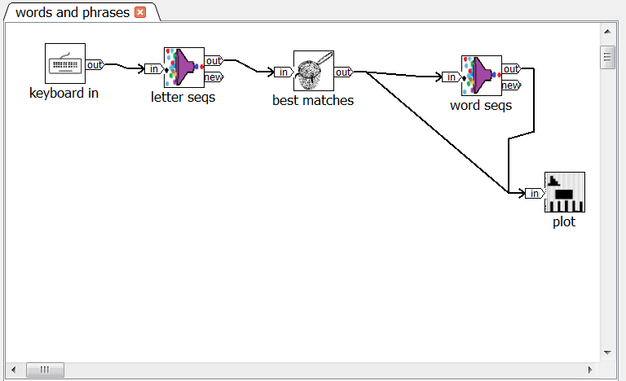
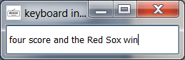
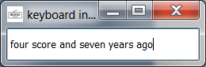
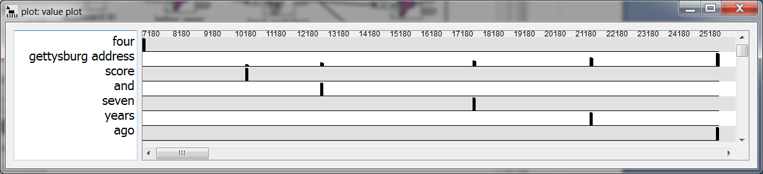
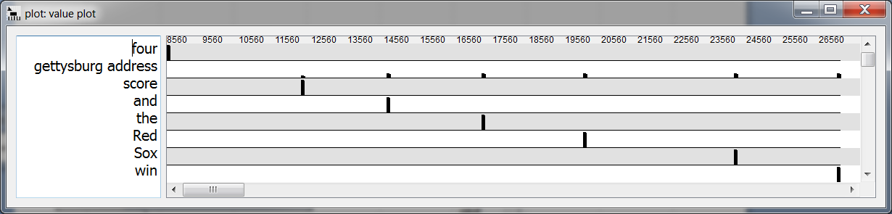
Phrases and Concepts

Slide 39
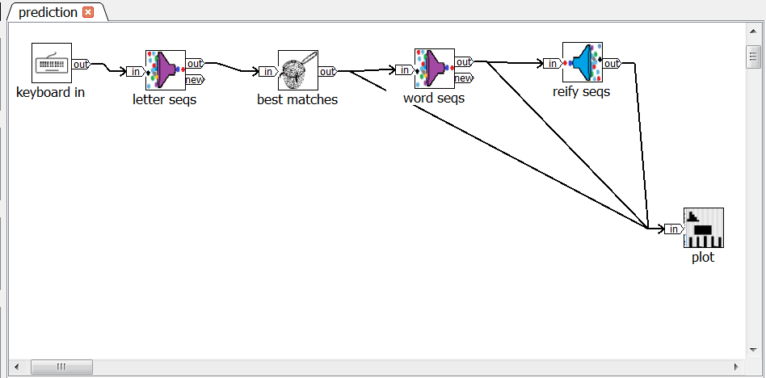
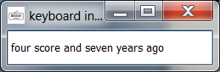
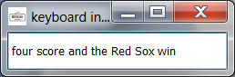
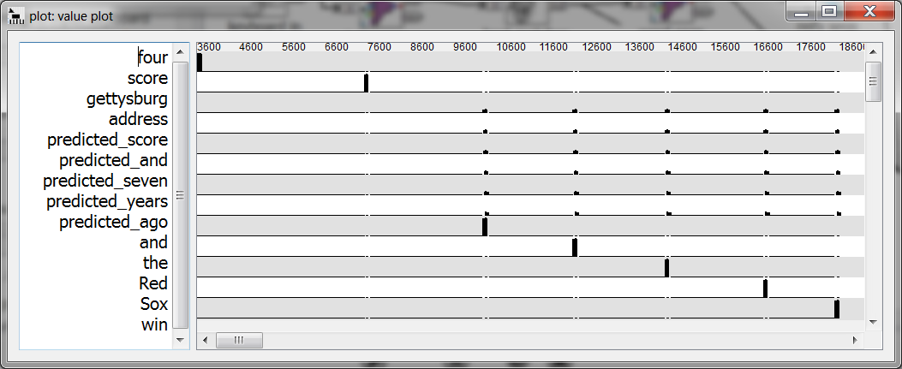
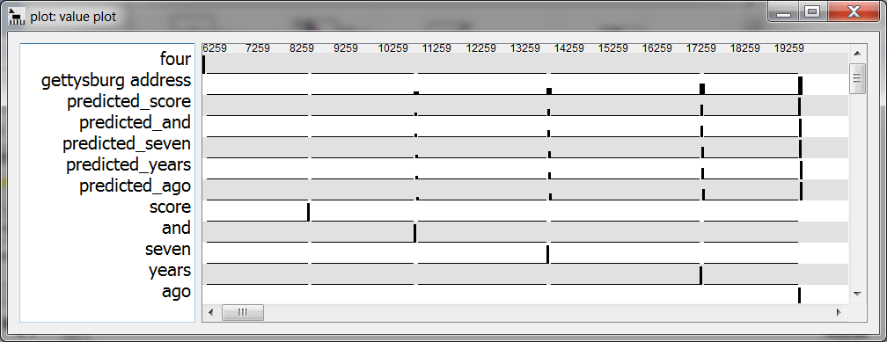
Prediction

Slide 40
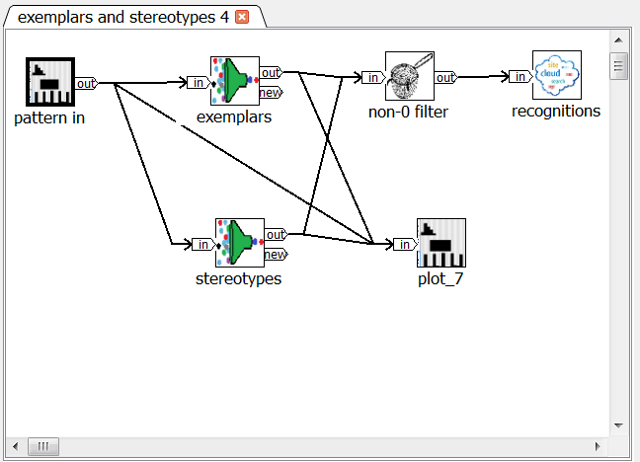
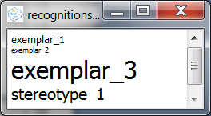
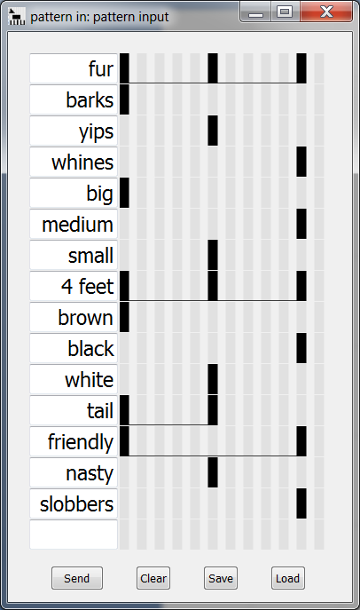
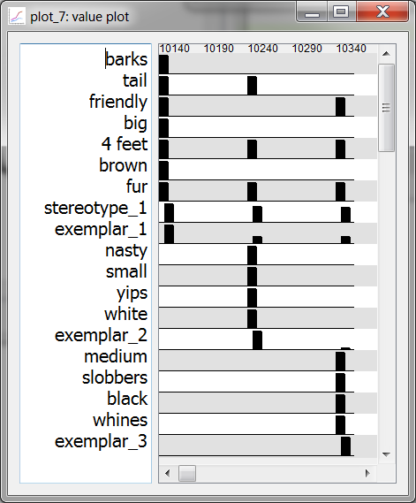
Classification

Slide 41
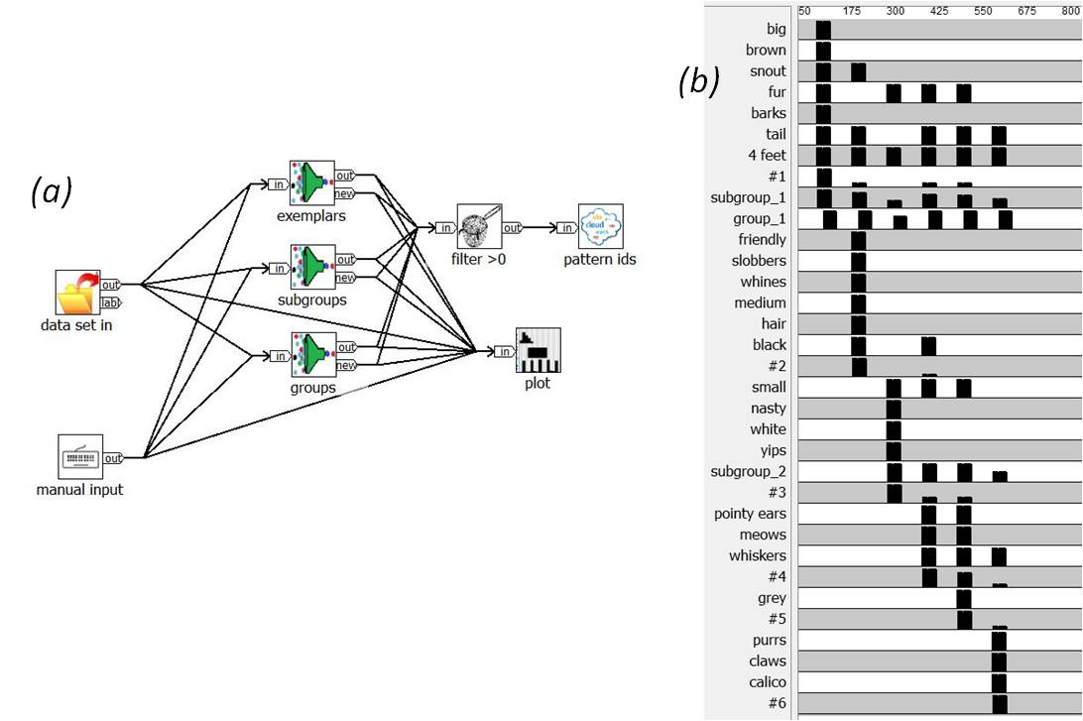
Classification "Hierarchy"
Exemplars, subgroups, groups
novelty threshold = 0.9
novelty threshold = 0.6
novelty threshold = 0.5

Slide 42
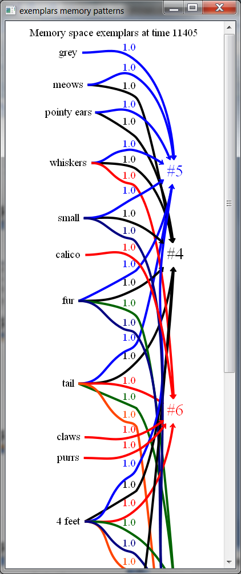




Slide 43



Context Priming

Slide 44

Context Priming

Slide 45
Cousins
from Daniel Kahneman "Thinking Fast and Slow"
"system 1"
automatic
parallel
fast
"system 2"
deliberate
sequential
slow(er)
perceptions
sensory
inputs
decisions
actions
learning
imagination
attention

Slide 46

Cousins
has_sibling
margaret
lee
paul
johnny
anne
has_parent
has_child
david
michael
jennifer
caroline
matthew
kevin
has_cousin

Slide 47



① lookup and reify known relationships
② generate parent, sibling, child relations
③ feedback for successive lookups
Cousins

Slide 48



① learn new relationship
Cousins

Slide 49
NeurOS Architecture Outline
applications
sub-assemblies
tools
modules
core
run-times

Slide 50
NeurOS Implementation Architecture
development tools
external libraries, systems
neural graphs
module & assembly
libraries
run-times
stand-
alone
GPUs,
custom
chips
distrib-
uted
multi-
process
single
process

Slide 51



NeurOS Architecture Detail
other
design
abstractions
text
editor
development
environment
Interactive Development Environment
module/
design library
files
core
builtins
neural graph design
subgraphs
wrappers
compilation
custom
functions
run-time
systems
other
engines
(hw/sw)
stand-alone code
run-time environments
single process engines
GPU
engines
multi-process engines
distrib-uted engines
existing
run-time (module, function) libraries
key:
planned
customization/
extension points

Slide 52

Module

Slide 53
Module Life-Cycle
create instance
start(vtime)
initialize external resources, internal state
schedule self-events if needed (e.g., input polling modules)
run(vtime)
access input signals
new events (changed signal values)
current signal values
recompute internal dynamic parameters (e.g., learning rate)
compute internal state changes
update shared global data
compute and send output signal events
non-zero virtual time delay
schedule self-events (input modules, decays, randomness)
finish(vtime): finalize/close external resources

Slide 54
Recursion
Sub-circuits recaptured as reusable modules
pattern spaces
module parameters
sub-graph module
pattern space map
graph parameters
pattern spaces

Slide 55
Virtual Time
Always moves forward
non-zero module processing vtime
variable processing vtimes model biology
enables (feedback) loops – vital !
Signals synchronized only where needed
enables parallelism
Synchronized with real time at edges
typical compromises: miss inputs, stumble

Slide 56
Master Work Queue/Loop (single process, multi-thread implementation)
Event send:
post event(vtime,signalID,new value)message on each output link
add run(module,vtime) to vtime-sorted work queue
Next iteration:
get run(module,vtime)s for lowest vtime and run
can be concurrent

Slide 57
Performance, Scalability
Signal value changes only
don't run modules where there are no signal changes
good-enough (square-wave) approximations
Patterns indexed by events
don't evaluate patterns that don't care about current signal changes
Multi-threading
Multi-process, distributed execution
Partitioning, load balancing
Custom hardware

Slide 58
Integrations, Extensions, Embeddings
Configurable modules
formatted file I/O, database access, pipes/sockets, web services, etc.
External library functions
Wrap external library/program
stdin/stdout/stderr, APIs
no write-shared state among module instances; no synchronization guarantees
Templated and custom modules

Slide 59
Active Projects
Industrial machine vibration monitoring, alerting, predictive maintenance, diagnosis
Virtual infant robot learning
Redistributable dev kit

Slide 60
NeurOS and NeuroBlocks in a Nutshell
Build cognitive systems… … by linking reusable modules … … into directed neural graphs/circuits
Broad applicability
Rapid iterative visual flow development
Open, extensible, embeddable, portable, scalable, …

Slide 61
Contact
http://www.cognitivity.technology
lee@cognitivity.technology
(Sign up to be notified when NeurOS development kit is available)
Make
stuff work
Be useful

